Slide 1
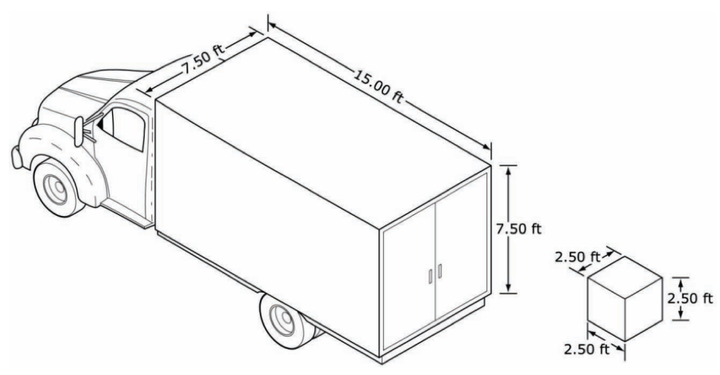
Moving Houses
Notes:
SET – I am moving houses next week. One of my friends have offered to help by lending her the truck. I have packed my goods in cubic packing boxes with side length of 2.5 ft. If the Truck has the dimensions as given, how many boxes can I fit in the Truck?
Ask students how they will solve the problem. Discuss the mathematical problem solving procedure and lead the discussion towards Volume (Filling empty 3D space – Volume - inside the truck with boxes).

Slide 2
Volume
Mr Parekh

Slide 3
Learning Intention
Success Criteria
Students will be able,
Explain how volume is used measured using cubic units
Interpret volume of a prism as area times length
Recall formula for calculating volume of a prism
You will
Complete the hands-on activity to obtain mathematical formula for calculating volume of the prisms
Complete Exercise 3.2 (Dr Dwyer’s textbook)

Slide 4
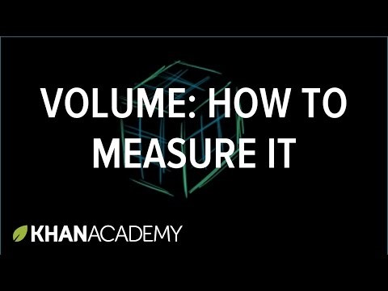
Measurements - Volume
Notes:
INPUT : Use the video or do the direct instruction yourself using the next slide
https://www.youtube.com/watch?v=xMz9WFvox9g&t=23s

Slide 5
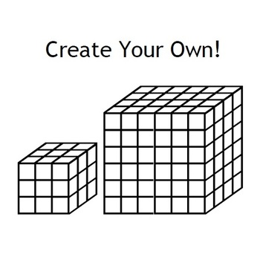
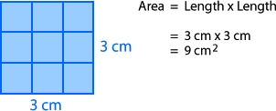

Measurements – Three dimensions
One dimension (1D) - Length
Two dimension (2D) - Area
Three dimension (3D) - Volume
Line 1
Line 2
Area 1
Area 2
Volume 1
Volume 2
Unit Length
Unit Area (unit²)
Unit Volume (unit³)
Notes:
Input : Summarise the information of the Video from previous slide. Or use the slide to carry out input instead of the video.

Slide 6
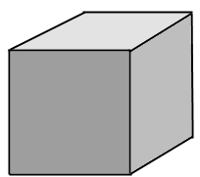
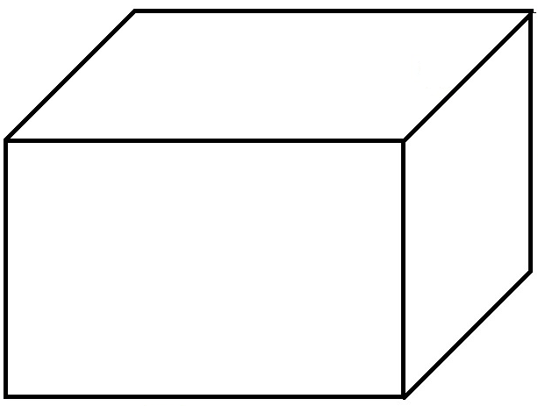
Activity - 1
The side length of an MAB block is 1 unit. How many MAB blocks are required to create following shapes? What is the volume of the shapes?
3 units
3 units
3 units
3 units
3 units
5 units
Notes:
Go through the answer for both of this shapes. Asks students if they can think of a formula?
Explanation : https://www.youtube.com/watch?v=E8tuMaDxgJM

Slide 7
24
7
30
Volume of a Prism
Date:
EQ : How do I calculate a volume of a prism?
Volume of any prism =
Base Area x Depth
What is a prism?
Prisms are shapes that have a pair of identical, parallel ends (the “base” and top) and straight sides (the “Depth”) perpendicular to the base
Any cut (called a cross-section) made through the shape parallel to the top or base will result in exactly the same shape as the base or the top.
Deoth
Depth
Base can be any face.
Base
Base
Depth
Depth
17
Notes:
INB notes
Input – Formalising the learning from Activity -1, by taking notes in the INB

Slide 8

3m
4m
5m
5m
7m
12m
Vol = Base Area × Depth
NOTE!! The base is the Δ front and height is 7
= 5 × 4 × 3
Vol = Base Area × Depth
= 60 cubic metres
= (½ × 12 × 5) × 7
= 210 m³
8cm
9cm
Note! r = 2
5cm
12cm
5cm
Note! Base is front trapezium & height is 12
4cm
Vol = Base Area × Depth
Vol = Base Area × Depth
= π × 2² × 5
= 62.83 cm³
= 672 cm³
Notes:
Modelling

Slide 9
Activity 2
Complete Exercise 3.2 (Dr Dwyer textbook, pg 35)

Slide 10
Closure – Review Success Criteria
Learning Intention
Success Criteria
Students will be able,
Explain how volume is used measured using cubic units
Interpret volume of a prism as area times length
Recall formula for calculating volume of a prism
You will
Complete the hands-on activity to obtain mathematical formula for calculating volume of the prisms
Complete Exercise 3.2 (Dr Dwyer’s textbook)

